Slide 1
WEEK 2a
COMPUTATIONAL MATHEMATICS

Slide 2
Outline
Introducing Matplotlib
Creating 2D line plot
References:
Jake VanderPlas, Jake. (2017). Chapter 4. Visualization with Matplotlib. Python Data Science Handbook: Essential Tools for Working with Data. O’Reilly Media, Inc.

Slide 3

Plotting with matplotlib
Importing matplotlib
Just as we use the np shorthand for NumPy and the pd shorthand for Pandas,
we will use some standard shorthands for Matplotlib imports:
>> import matplotlib as mpl
>> import matplotlib.pyplot as plt
The plt interface is what we will use most often

Slide 4
Setting Styles
pyplot has a method ‘style’ to choose appropriate aesthetic styles for the figures
e.g. '_classic_test', 'bmh', 'classic', 'dark_background’, etc.
>> plt.style.use('classic')
For complete reference of setting style:
https://matplotlib.org/3.1.1/gallery/style_sheets/style_sheets_reference.html

Slide 5
Basic commands
plot()
Given a single list or array, plot() assumes it’s a vector of y-values
Automatically generates an x vector of the same length with consecutive integers beginning with 0
To override default behavior, supply the x data: plot(x,y )
where x and y have equal lengths

Slide 6
Basic commands
show()
Should be called at most once per script
Last line of the script
Then the GUI takes control, rendering the figure
Hangs until the figure is dismissed or close() issued

Slide 7
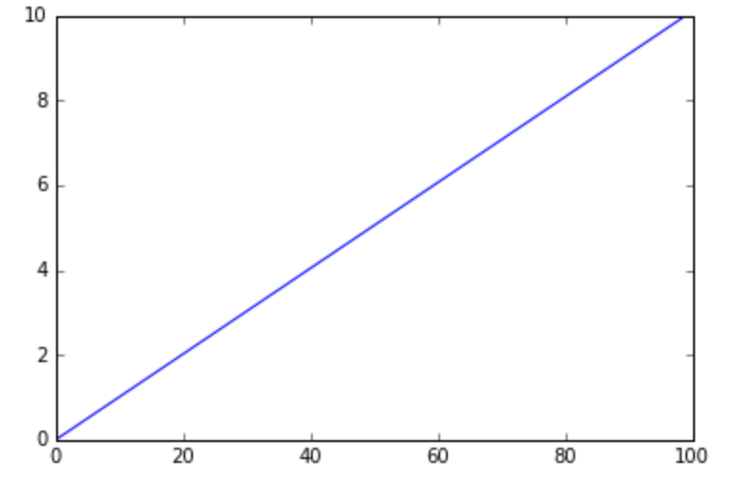
Basic commands
Example: to plot a line of given x
>> x = np.linspace(0, 10, 100)
>> plt.plot(x)
>> plt.show()

Slide 8
Basic commands
In place of show(), can save the figure to with, say,
> plt.savefig('fig1.png')
Saved in the same folder as the script
Override this with a full pathname as argument—e.g.,
> plt.savefig('E:\\SomeOtherFolder\\fig1.png')
Supported formats: emf, eps, pdf, png, ps, raw, rgba, svg, svgz
If no extension specified, defaults to .png

Slide 9
Interactive – vs – Static Mode
In interactive mode:
objects are displayed on another window as soon as they’re created
Also we can get zoom-able & resize-able notebook.
This is the best for quick tests where you need to work interactively.
You can add more lines
The command line doesn’t hang

Slide 10
Interactive – vs – Static Mode
In static mode:
Objects are displayed after all the scripts complete.
Only draws the images, not interactive / zoom-able but it works well.
You can’t add more lines after the image has been shown
The command line hang until we close the figure window (in python shell)
The image will be shown directly below the code cell that produced it (in IPython)

Slide 11
Interactive – vs – Static Mode
If you are using IPython/Jupyter notebook
>> %matplotlib notebook
will lead to interactive plots embedded within the notebook
>> %matplotlib inline
will lead to static images of your plot embedded in the notebook

Slide 12
Interactive – vs – Static Mode
If you are using Python shell
Use ion() to turn on interactive mode, ioff() to turn it off
Example
Turn on interactive mode and plot a line
>> plt.ion()
>> plt.plot([1,2,3,4])
[<matplotlib.lines.Line2D object at 0x02694A10>]
A figure appears with this line on it
The command line doesn’t hang

Slide 13
Interactive – vs – Static Mode
Plot another line
>> plt.plot([4,3,2,1])
[<matplotlib.lines.Line2D object at 0x00D68C30>]
This line is shown on the figure as soon as the command is issued
To close
>> plt.close()

Slide 14
Interactive – vs – Static Mode
Turn off interactive mode
>> plt.ioff()

Slide 15
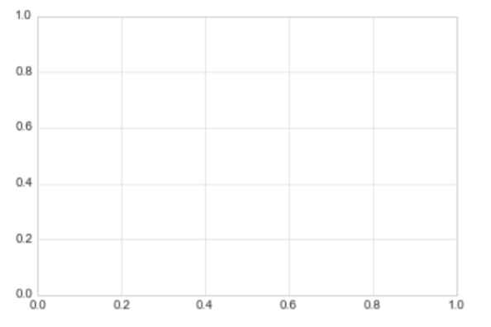
Create Figure
In Matplotlib, the figure can be thought of as a single container that contains all the objects representing axes, graphics, text, and labels.

Slide 16
Create Figure
>> fig = plt.figure()
plt.figure() can also be used to create more than one figure in interactive mode by specifying the index inside the bracket: plt.figure(2)

Slide 17
Adjusting the Plot: Line Colors and Styles
plot() has a format string argument specifying the color and line type
Goes after the y argument (whether or not there’s an x argument)
Can specify one or the other or concatenate a color string with a line style string in either order
Default format string is 'b-' ( solid blue line)

Slide 18
Adjusting the Plot: Line Colors and Styles
Some color abbreviations
b (blue), g (green), r (red), k (black), c (cyan)
Can specify colors in many other ways (e.g., RGB triples)
Some line styles that fill in the line between the specified points
(solid line), -- (dashed line), -. (dash-dot line), : (dotted line)
Some line styles that don’t fill in the line between the specified point
o (circles), + (plus symbols), x (crosses), D (diamond symbols)

Slide 19
Adjusting the Plot: Line Colors and Styles
For a complete list of line styles and format strings,
http://matplotlib.sourceforge.net/api/pyplot_api.html#module-matplotlib.pyplot
Look under matplotlib.pyplot.plot()

Slide 20
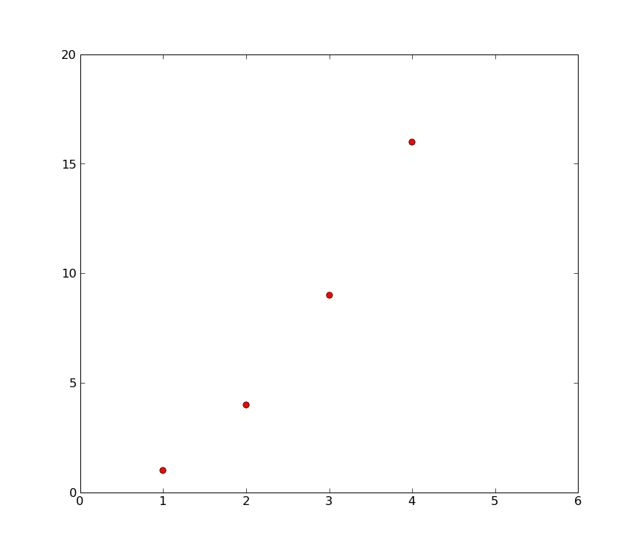
The axis
The axis() is used to set the box size of the figure
If we call it plt.axis() without any parameter, it returns the current axes limits [xmin, xmax, ymin, ymax]
If we specify the parameter [xmin, xmax, ymin, ymax], it can adjust the display of the figure
We can use special options, like: axis(‘auto’), axis(‘square’)
Example
>> plt.plot([1,2,3,4], [1,4,9,16], 'ro')
[<matplotlib.lines.Line2D object at 0x034579D0>]
>> axis([0, 6, 0, 20])
>> [0, 6, 0, 20]

Slide 21
More on using plot()
Generally work with arrays, not lists
All sequences are converted to NumPy arrays internally
We can plot several lines with different format styles in one command using arrays

Slide 22
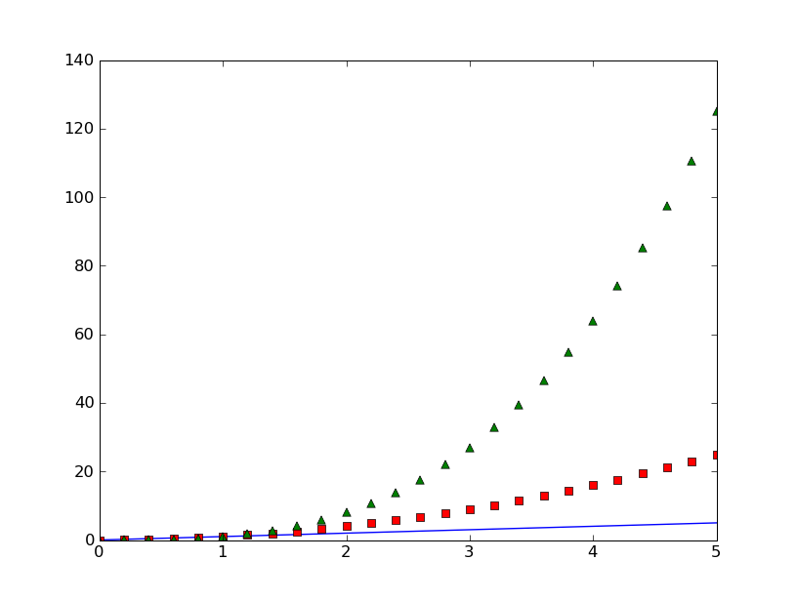
More on using plot()
>> t = np.arange(0.0, 5.2, 0.2)
>> plt.plot(t, t, t, t**2, 'rs', t, t**3, 'g^')
[<matplotlib.lines.Line2D object at 0x02A6D410>,
<matplotlib.lines.Line2D object at 0x02A6D650>,
<matplotlib.lines.Line2D object at 0x02A6D8D0>]

Slide 23
More on using plot()
Property | Values
alpha | The alpha transparency on 0-1 scale
antialiased | True | False - use antialised rendering
color | a matplotlib color arg
label | a string optionally used for legend
linestyle | One of -- : -. -
linewidth | a float, the line width in points
marker | One of + , o . s v x > < ^
markeredgewidth | The line width around the marker symbol
markeredgecolor | The edge color if a marker is used
markerfacecolor | The face color if a marker is used
markersize | The size of the marker in points
Lines you encounter are instances of the Line2D class
Instances have the following properties
alpha = 0.0 is complete transparency, alpha = 1.0 is complete opacity

Slide 24
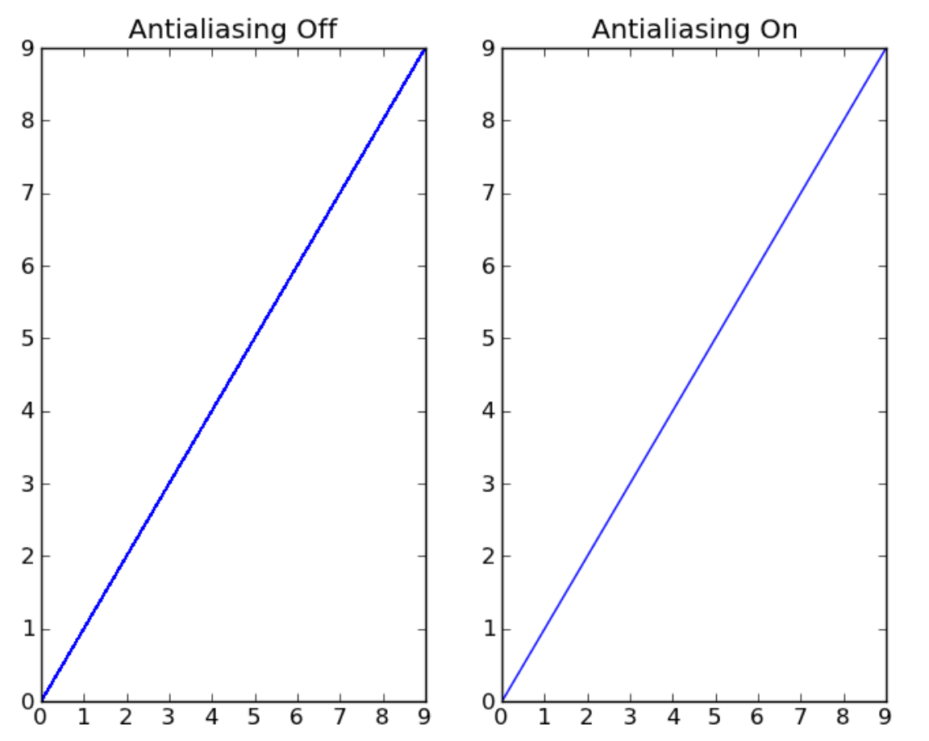
More on using plot()
plt.plot(range(10), antialiased=False)
plt.plot(range(10), antialiased=True)
Non-antialiased plotting will be faster, so if you're plotting a large amount of data, it can be worthwhile to turn it off.

Slide 25
More on using plot()
One of 3 ways to set line properties: Use keyword line properties as keyword arguments—e.g.,
>> plt.plot(x, y, linewidth=2.0)
Another way: Use the setter methods of the Line2D instance
For every property prop, there’s a set_prop() method that takes an update value for that property
To use this, note that plot() returns a list of lines
The following has 1 line with tuple unpacking
>> line, = plt.plot(x, y, 'o')
>> line.set_antialiased(False)

Slide 26
More on using plot()
The 3rd (and final) way to set line properties: use function setp()
1st argument can be an object or sequence of objects
The rest are keyword arguments updating the object’s (or objects’) properties
E.g.,
>> lines = plt.plot(x1, y1, x2, y2)
>> plt.setp(lines, color='r', linewidth=2.0)

Slide 27
Text
The text commands are self-explanatory
xlabel()
ylabel()
title()
text()
In simple cases, all but text() take just a string argument
text() needs at least 3 arguments:
x and y coordinates (as per the axes) and a string
All take optional keyword arguments or dictionaries to specify the font properties
They return instances of class Text

Slide 28
Text
The following font properties of Text instances can be set
Property | Values
alpha | The alpha transparency on 0-1 scale
color | a matplotlib color argument
fontangle | italic | normal | oblique
fontname | Sans | Helvetica | Courier | Times | Others
fontsize | a scalar, eg, 10
fontweight | normal | bold | light 4
horizontalalignment | left | center | right
rotation | horizontal | vertical
verticalalignment | bottom | center | top

Slide 29
Text
Three ways to specify font properties: using
setp
object oriented methods (We skip this)
font dictionaries
Use setp to set any property
t = plt.xlabel('time')
plt.setp(t, color='r', fontweight='bold')
Also works with a list of text instances—e.g.,
labels = plt.getp(gca(), 'xticklabels')
plt.setp(labels, color='r', fontweight='bold')

Slide 30
Text
All text commands take an optional dictionary argument and keyword arguments to control font properties
E.g., to set a default font theme and override individual properties for given text commands
>> font = {'fontname' : 'Courier',
'color' : 'r',
'fontweight' : 'bold',
'fontsize' : 11}
>> plt.plot([1,2,3])
>> plt.title('A title', font, fontsize=12)
>> plt.text(0.5, 2.5, 'a line', font, color='k')
>> plt.xlabel('time (s)', font)
>> plt.ylabel('voltage (mV)', font)

Slide 31
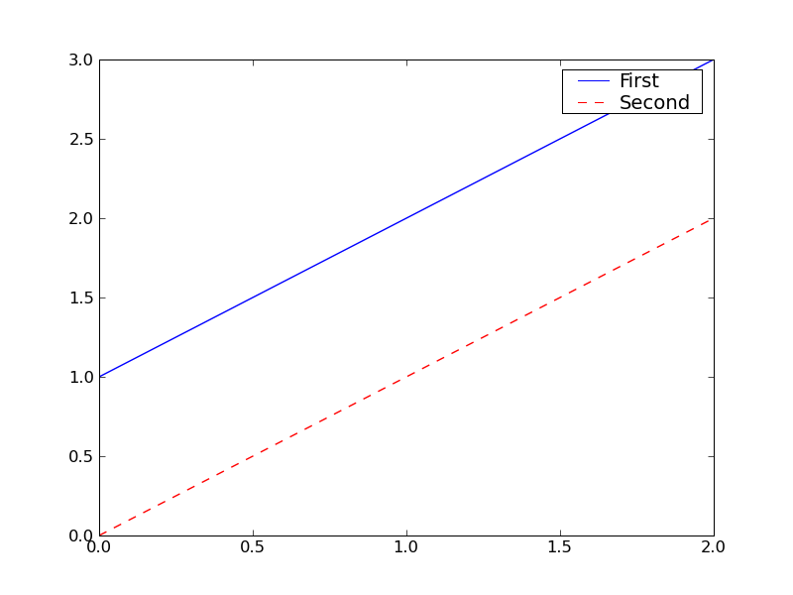
Legends
A legend is a box (by default in upper right) associating labels with lines (displayed as per their formats)
legend(lines, labels)
where lines is a tuple of lines, labels a tuple of corresponding strings
>> lines = plt.plot([1,2,3],'b-',[0,1,2],'r--')
>> plt.legend(lines, ('First','Second'))

Slide 32
Legends
If there’s only 1 line, be sure to include the commas in the tuples
legend((line1,), ('Profit',))
Use keyword argument loc to override the default location
Use predefined strings or integer codes
‘upper right’ 1
‘upper left’ 2
‘lower left’ 3
‘lower right’ 4
‘right’ 5
‘center left’ 6
‘center right’ 7
‘lower center’ 8
‘upper center’ 9
‘center’ 10
E.g.,
legend((line,), ('Profit',) , loc=2)

Slide 33
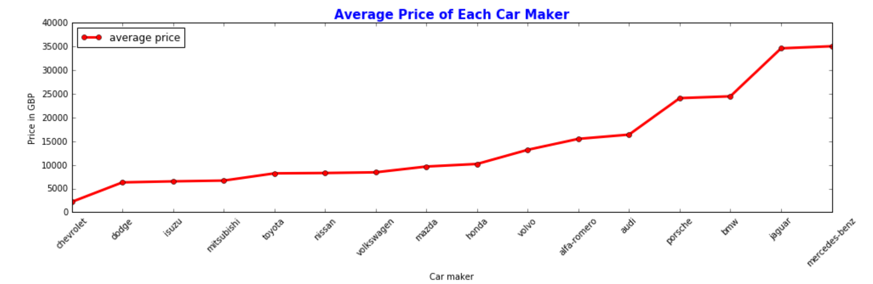
Your exercise
From the file: automobile.csv, please create the visualization of the data of average price of each car maker. The expected output is as below:
Hint: use xticks(rotation=45) to rotate the x label

Slide 34
Link to DATASET
http://bit.ly/dataset_compmath

Slide 35
Useful resources
Documentation page (links): http://matplotlib.org/contents.html
PyplotTutorial (8 pp.)
http://matplotlib.sourceforge.net/users/pyplot_tutorial.html
User’s Guide
http://matplotlib.org/users/
Refer to as needed
Cookbook / Matplotlib
http://matplotlib.org/api/cbook_api.html
Lots of good examples
Shows figure, link to page giving code and explanation

Slide 36
Useful resources
matplotlib FAQ
http://matplotlib.sourceforge.net/faq/index.html
Using matplotlib in a python shell
http://matplotlib.sourceforge.net/users/shell.html
For performance, by default, matplotlib defers drawing until the end of the
But, to test things out interactively (in the shell), usually want to update after every command
Shows how to do this
Do it with IPython

Slide 37
Useful resources
Examples
http://matplotlib.org/examples/
Just names under headings, but names are descriptive
The “What's new” page
http://matplotlib.org/users/whats_new.html
Every feature ever introduced into matplotlib is listed here under the version that introduced it
Often with a link to an example or documentation
Global Module Index: http://matplotlib.org/py-modindex.html
Documentation on the various modules
This and the next 2 are comprehensive
The Matplotlib API: http://matplotlib.sourceforge.net/api/
Documentation on the various packages
Pyplot documentation (142 pp.): http://matplotlib.org/api/pyplot_api.html

Slide 38
Pyplot and pylab
Pylab is a module in matplotlib that gets installed alongside matplotlib; and matplotlib.pyplot is a module in matplotlib.
Pyplot provides the state-machine interface to the underlying plotting library in matplotlib. This means that figures and axes are implicitly and automatically created to achieve the desired plot. Setting a title will then automatically set that title to the current axes object.
Pylab combines the pyplot functionality (for plotting) with the numpy functionality (for mathematics and for working with arrays) in a single namespace, For example, one can call the sin and cos functions just like you could in MATLAB, as well as having all the features of pyplot.
The pyplot interface is generally preferred for non-interactive plotting (i.e., scripting). The pylab interface is convenient for interactive calculations and plotting, as it minimizes typing. Note that this is what you get if you use the ipython shell with the --pylab option, which imports everything from pylab and makes plotting fully interactive.

